Slide 1
GPS Team 2016-2017
By Nick,Jackson,Kendalynn,Carrie,cole,shealee

Slide 2
Text Features on a map
Text features on a map are an example of landforms,political map,physical map,and geographical map.

Slide 3
Terrain Differences
Terrain differences is the difference between landforms.Like the plains,the hills,mountians,valleys,and bodies of water.

Slide 4
How to make a way point
First,from any screen press and hold GOTO for 2 seconds and the mark screen is displayed.
Second, the save button is highlighted and you can press ENTER to save the waypoint using the default name and icon.

Slide 5
How to delete a waypoint
First,power up from any screen push menu push DATABASE push user waypoint push list waypoints push menu push delete waypoint push enter and answer YES!!

Slide 6
what are parallels ?
Parallels are also known as lines of longitude and latitude and commonly known as equator (the equator runs west to east).

Slide 7
What are meridians ?
different Meridians are lines of latitude there are meridians one meridian is the prime meridian the prime meridian runs north to south.

Slide 8
Maps
Maps Show you the exact location or destination. Maps also show lines of latitude and longitude. Maps can help you know how far a destination is from a location by using lines of latitude and longitude.

Slide 9
Map Legends
Map legends are a symbols that tell you where objects are. Examples of a map legend are if you see a box an a map that has symbols that represent land forms.

Slide 10
Colors Of The Map
The colors on the map represents certian features also colors can represent weather,climate,and regions.

Slide 11
WHY WE WOULD MAKE MAPS
WHY YOU MAKE MAPS IS TO SEE YOUR EXACT LOCATION OR DESTINATION.
MAPS ALSO HELP YOU SEE HOW FAR YOUR DESTNATION IS BY USING LINES OF LATITUDE AND LONGITUDE

Slide 12
Using the GPS

Slide 13
GPS Team
Jackson, Cole, Nick, Kendalynn, Shealee, and Carrie

Slide 14
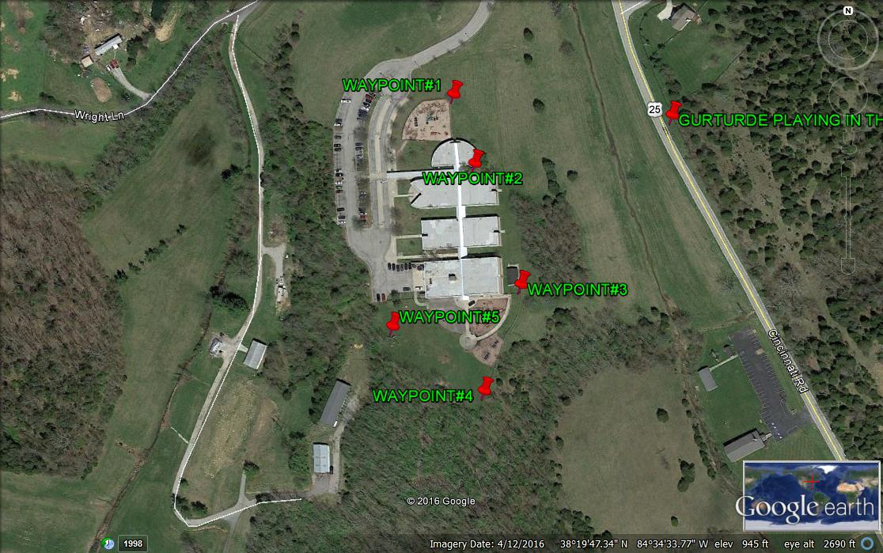
Map of Land Navigation Course for 5th Grade NES

Slide 15
Map of School Grounds – created by hand.

Slide 16
Course Design Process
Course for the activity was chosen.
A hand drawn map was created and used to determine distance of points for use with GPS handheld units.
Google maps was used to locate school grounds and determine if placement of waypoints would work.

Slide 17
Creating Map
Google Maps was used for map creation.
We had to input the grid location from the handheld GPS units into Google maps to match waypoints on the ground to the actual map.
We then used thumb tacks to mark the waypoints from our GPS units to the map software on Google Maps.

Slide 18
GPS Units

Slide 19
Data Collection - Waypoints
The Data collected was from the information on location found on our GPS handheld units.
Data was also collected on the number of students that could complete the course using a handheld map and the GPS units in the time given – 45 minutes.

Slide 20
Results – Data Collection
5 waypoints were created and used on the land navigation course for all 5th grade students.
There were 16 groups with approximately 4 students in each group.
10 groups completed the course with 100% accuracy.
5 groups completed the course with an 80% accuracy.
1 group did not complete the course.

